Slide 1
Integrate Domain Knowledge in Training CNN for Ultrasonography Breast Cancer Diagnosis

Slide 2
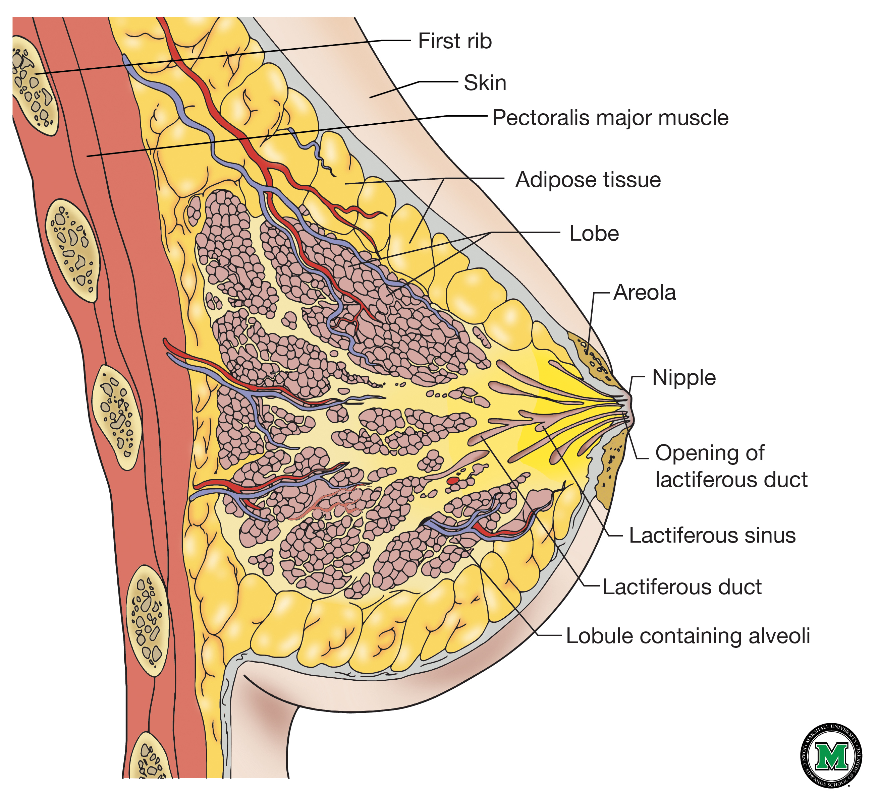
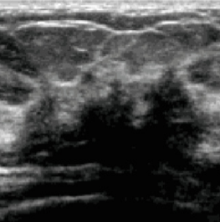
问题意义
乳腺癌是女性最高发肿瘤
最有效的诊断方法之一是钼靶，但是在致密的乳腺中，敏感性很低，导致很多不必要的乳腺穿刺
有经验的超声医生在区分乳腺的良恶性肿瘤上准确率更高
另外超声检查无辐射，更经济，方便
因此在乳腺癌的诊断上，乳腺超声检查已经慢慢成为乳腺钼靶的替代选择

Slide 3
数据集
This Paper：
良性（benign）： 491 恶性(malignant)： 426 正常(normal)： 1016
Other Papers:
Database A contains 250 breast cancer images, 100 benign and 150 malignant.
https://data.mendeley.com/datasets/wmy84gzngw/1
公开数据集：us-dataset.zip
Dataset B comprises 163 (53 malignant and 110 benign) images
http://www2.docm.mmu.ac.uk/STAFF/m.yap/dataset.php

Slide 4
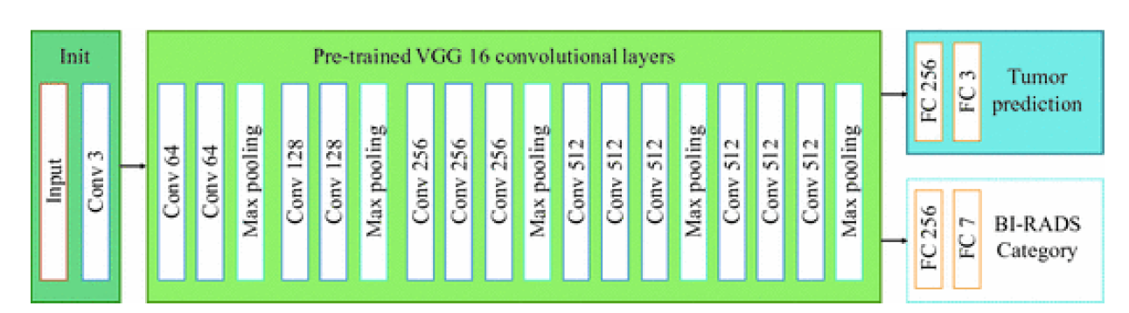
方法

Slide 5
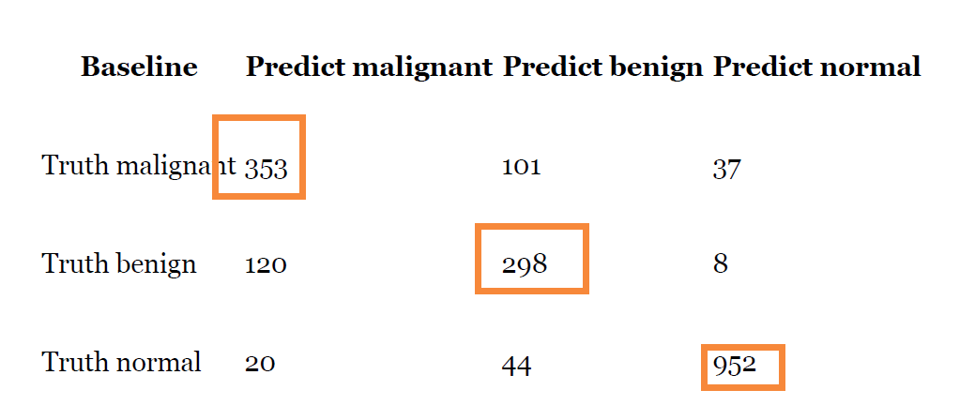
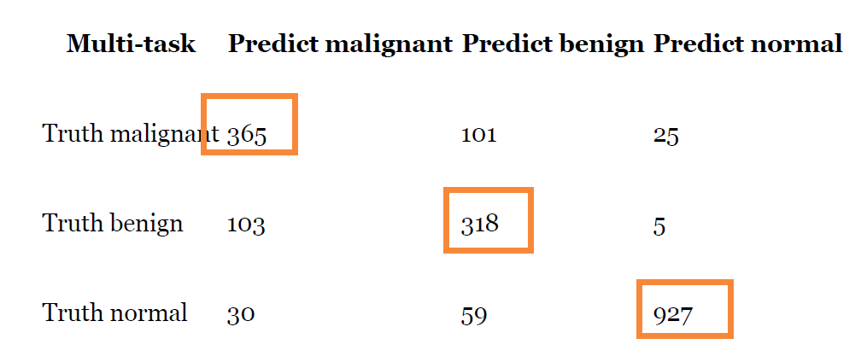
1. 肿瘤预测与BI-RADS的Multi-task 精度需要进一步提高
Multi-task Learning：肿瘤预测与BI-RADS分级
baseline method：82.9%，multi-task network slightly increased to 83.3%.
Normal Predict: 96.7% (Baseline: 95%)
Malignant and Benign Predict: 74.3% (baseline: 71.9%)
malignant tumor and benign lump prediction happened in BI-RADS category 4 images (baseline: 57.5%, multi-task: 54.9%).

Slide 6
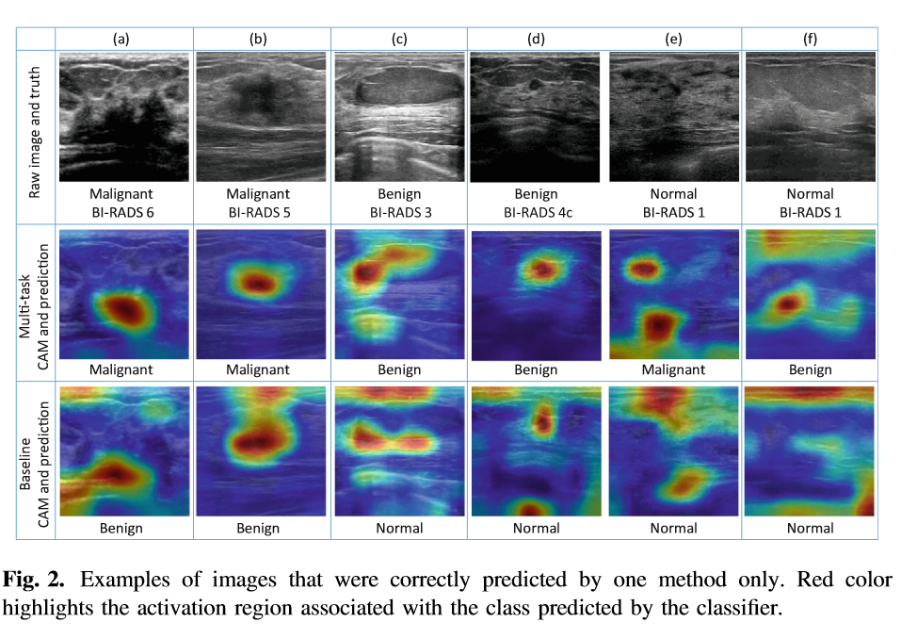
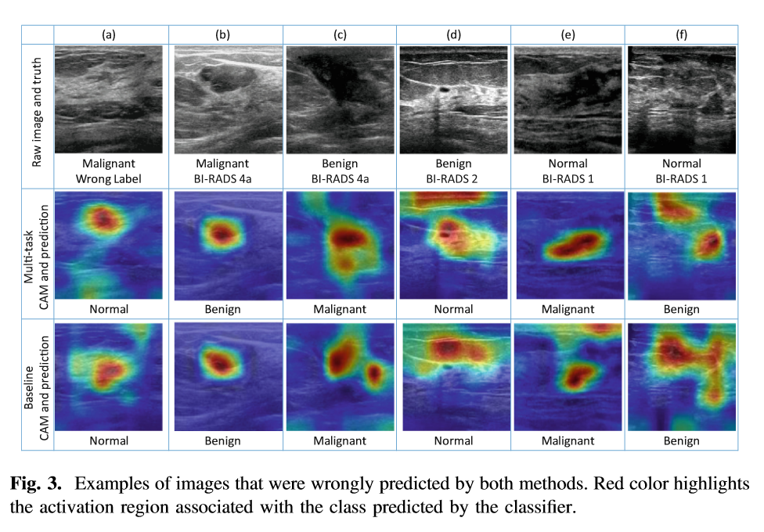
Error Analysis
Class Activation Map (CAM) of the last convolutional layer was visualized

Slide 7
Contribution
自己建立的数据集
采用CNN预测超声图像中的乳腺肿瘤,领域知识已整合到训练过程中。
在区分具有肿块和正常的图像时获得了可喜的结果。
尽管这不是分割任务，但经过训练的分类器的激活图仍可以正确突出显示图像中的肿块区域。
在鉴别恶性肿瘤和良性肿块方面也获得了合理的结果。

Slide 8
Paper
BIRADS Features-Oriented Semi-supervised Deep Learning for Breast Ultrasound Computer-Aided Diagnosis
Erlei Zhang, Stephen Seiler, Mingli Chen, Weiguo Lu, Xuejun Gu
(Submitted on 9 Aug 2019)

Slide 9
Datasets
Data Set I — Public UDIAT
Segmentation dataset
160 images include 53 images with malignant lesions and 107 with benign lesions
Data Set II — In-house Clinical Dataset UTSW
295 images contain 205 benign lesions and 90 malignant lesions
images were marked with two or four boundary points.
A marker-controlled watershed segmentation method was used to create the tumor boundary

Slide 10
Method: SCAE
传统的SCAE
训练过程分为两步：
1）ORIGIN IMAGE/BFMs作为网络的input, 原始图像作为网络的output，无监督训练a stacked convolutional auto-encoder (SCAE) neural network，保留input和encoder
2) 在encoder的基础上，Fine-tuning the classification network only with supervised learning （肿瘤的良恶性）

Slide 11
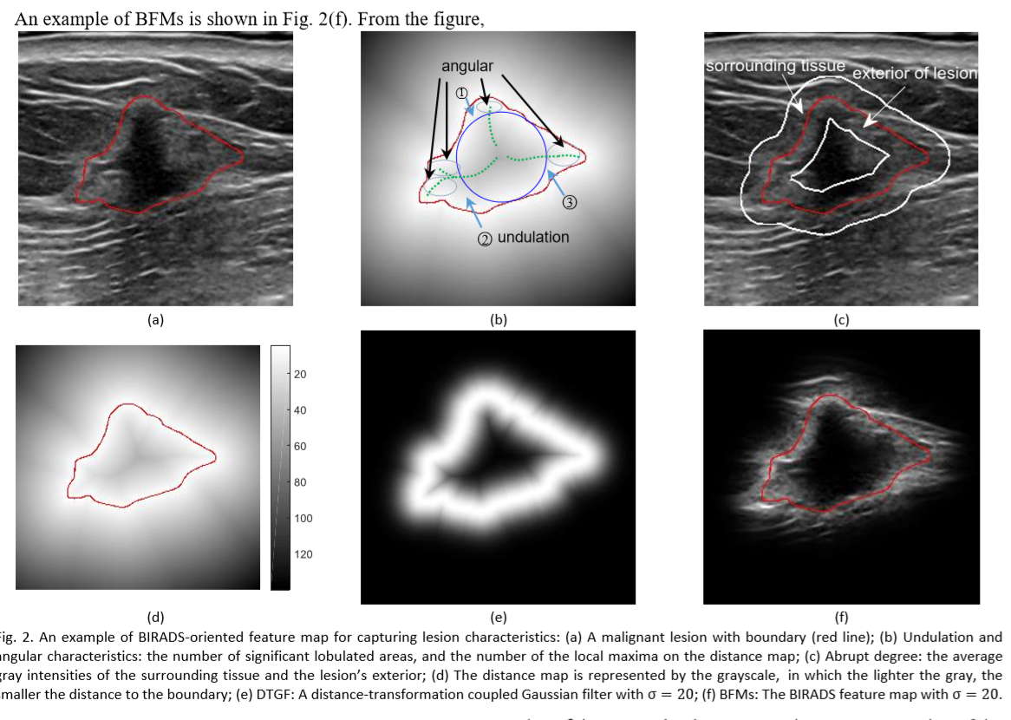
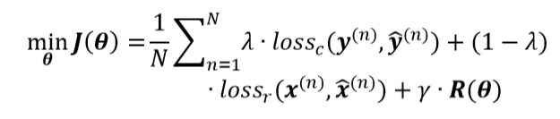
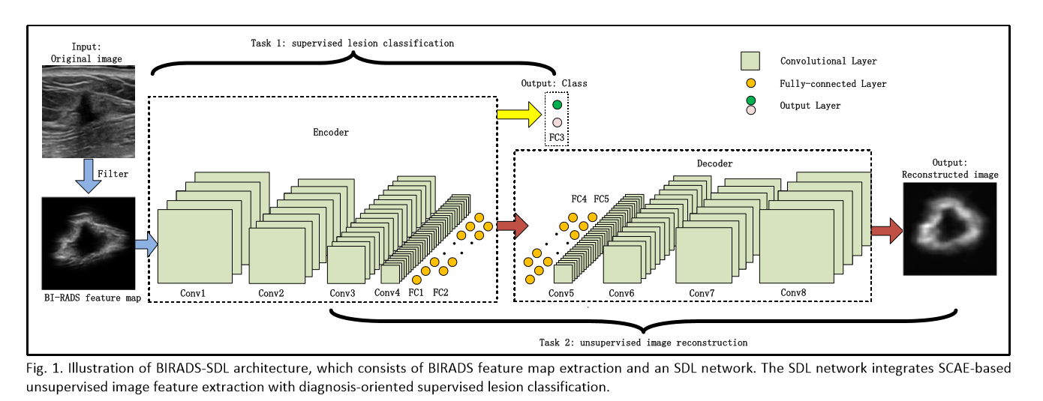
Method: BIRADS-SDL network
New method: semi-supervised deep learning (SDL)
1）ORIGIN IMAGE/BFMs作为网络的input,
原始图像及肿瘤良恶性作为网络的output，同时训练网络
2) loss:

Slide 12
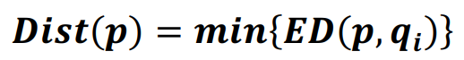
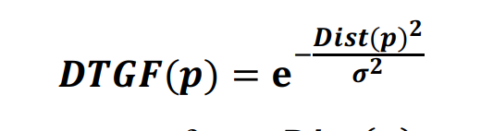

Slide 13
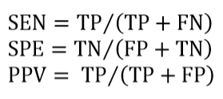
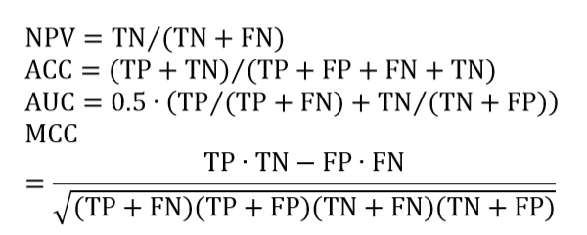
Performance Metric
ACC： accuracy
AUC： area the under receiver operating
characteristic curve
SEN：sensitivity
SPE：specificity
PPV：positive predictive value
NPV：negative predictive value
MCC ：negative predictive value
In the experiments, TP is the number of true positives (malignant breast tumor), FN is the number of false negatives (benign breast tumor), TN is the number of true negatives, and FP is the number of false positives

Slide 14
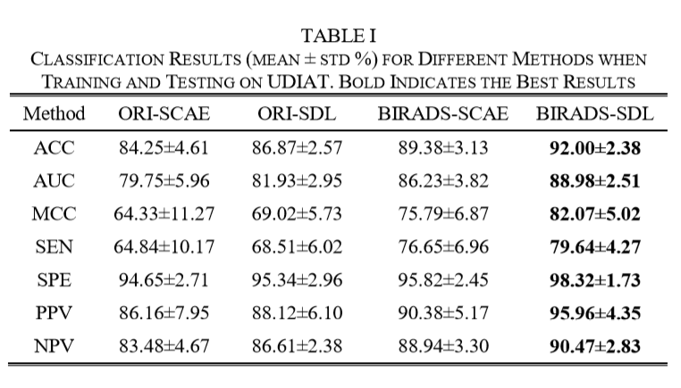
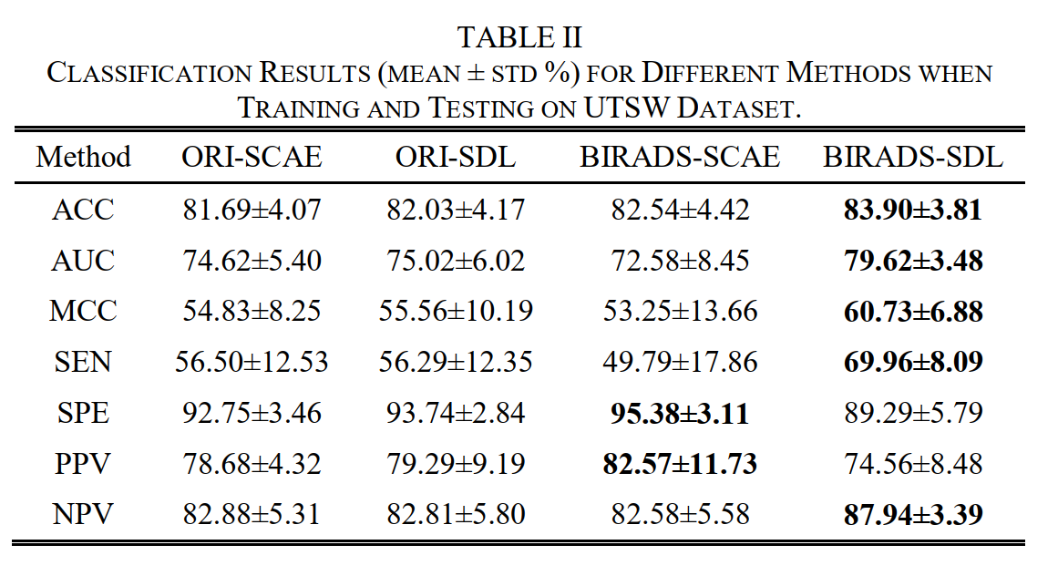
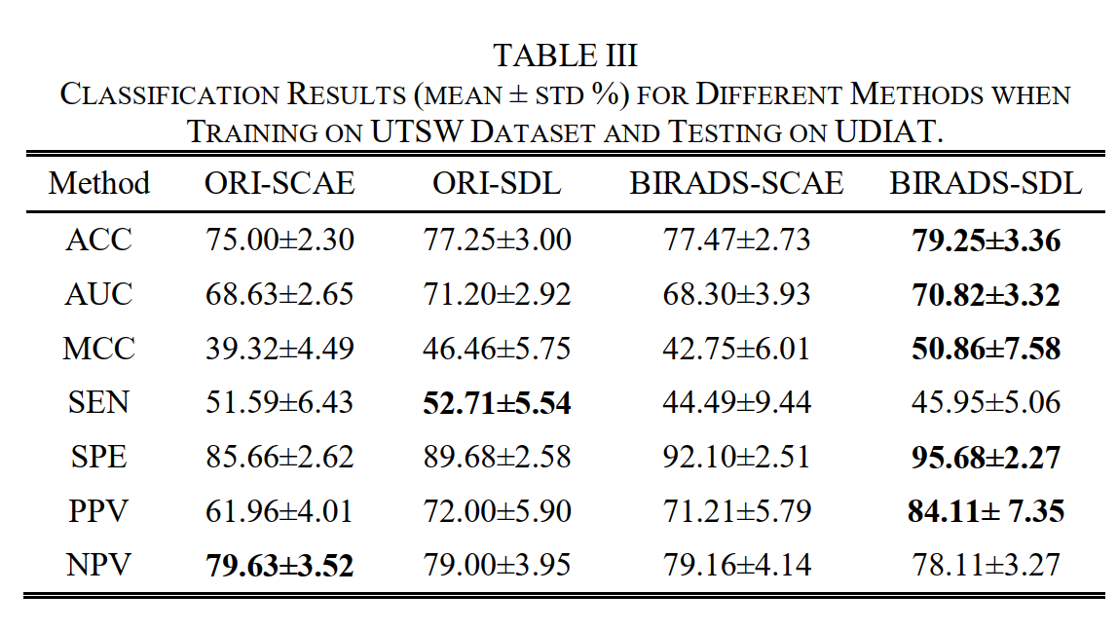
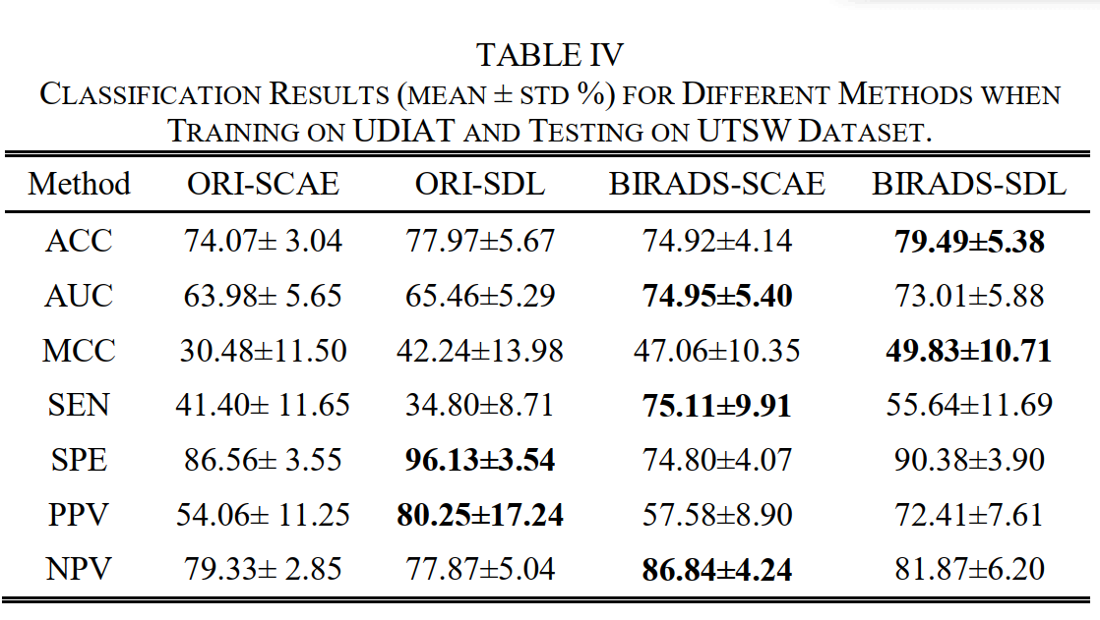
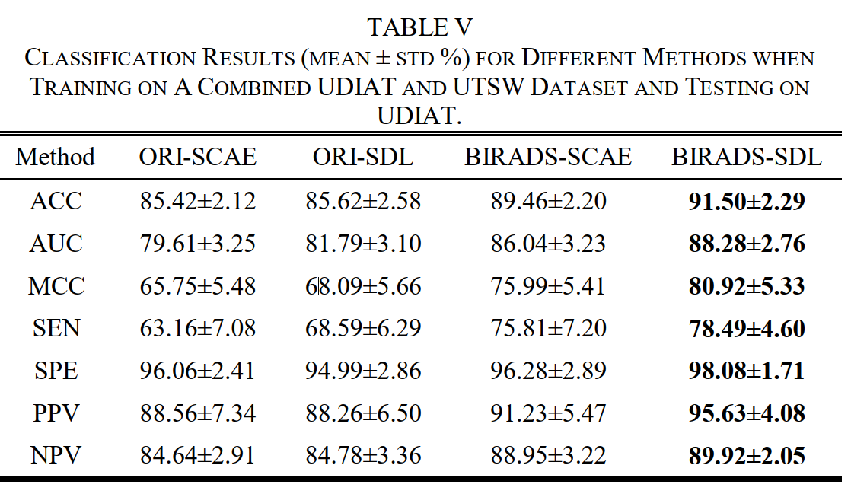
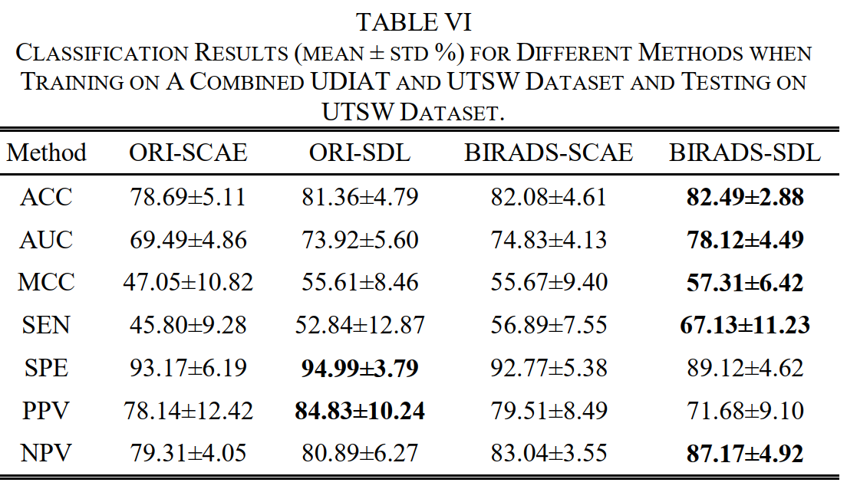
Result
dataset1
dataset2
dataset1 train(80%)上训练和在dateset2 test(50%)
dataset2 train(80%)上训练和在dateset1 test(50%)
组合 dateset1 (50%)和dateset 2 (80%) test on dateset1
组合 dateset1 (50%)和dateset 2 (80%) test on dateset 2

Slide 15
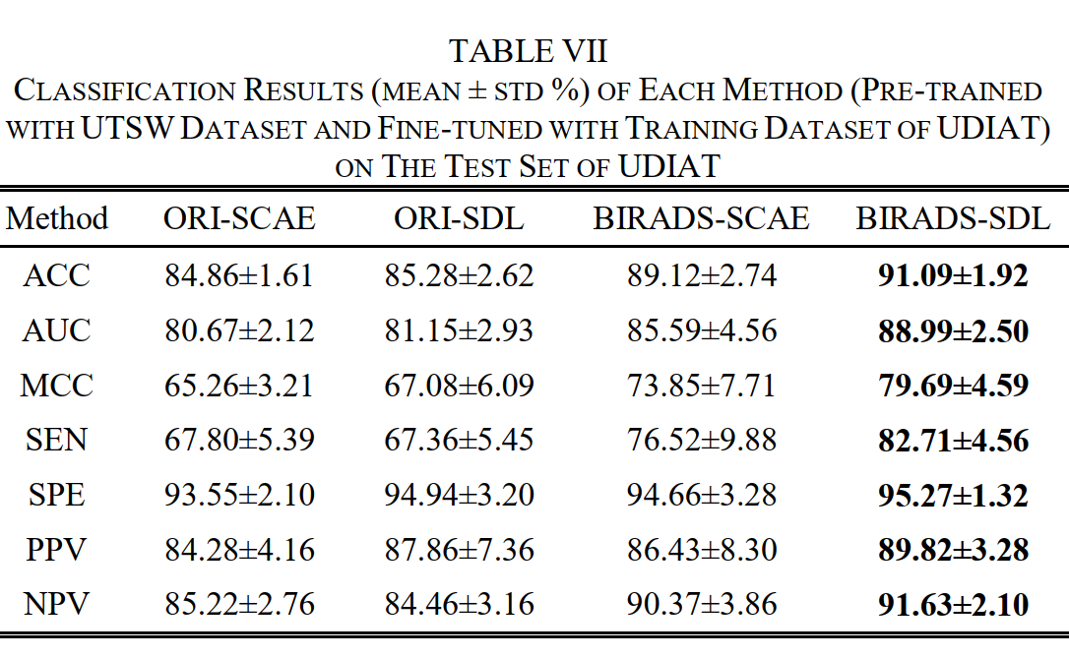
在dataset 1预训练，dateset2 50%微调，test on dateset 2 50%

